Slide 1

HYBRID FOOD IMAGE PROCESSING
Under The Guidance Of:
Mr. Shubhajit Panda
Team Members :
Ayush Hang Verma
Pravesh Sharma
Aditya Ujwall
Yashu Hang Subba
Priyankar Chhetri

Slide 2

TABLE OF CONTENT
S.No | Title | Slide No
1. | Abstract | 3
2. | Problem Statement | 4
3. | Tools And Technologies | 5
4. | Solution Strategies | 6-7
5. | Research Design / Workflow / Methodology | 8-9
6. | Gantt Chart | 10
7. | Conclusion | 11
8. | References | 12-13

Slide 3
ABSTRACT
In this day and age almost, every person wants live a healthy life and the best way to achieve that is by knowing what you eat and by having good food habits.
Knowing what you eat gives you the transparency you need to achieve good health and to fulfil the goal of living a healthy and holistic life.
Now imagine a life where you can have this transparency within arms reach, having the means to know how much you are eating and what it is made of and if it is actually good for you or not.
You just upload a picture of what you eat and you get to know the food category, number of calories and the ingredients that are there in the food you are consuming.
The increasing prevalence of food allergies and dietary restrictions necessitates precise information about the composition of food items we consume.

Slide 4
PROBLEM STATEMENT
- Lack of quick and accurate information about meals
- Lack of nutritional transparency when it comes to kitchen prepared food
- Food diversity in India, hence lack regional and ethnic food varieties
- Manual intervention when it comes to food portion tracking
- Portion estimation relies on assumptions
- Missing out on sensitive health information due to the lack of food logging
- Visual food records increases accountability regarding eating patterns
- Assists patients with medical conditions which are heavily dependent on food habits
- Support for long term dietary habit tracking improving the prevention of chronic diseases
- Provides data for research on relationship between dietary habits and diseases
- Records change in food patterns across various cultures
- Automates food inspections and consistency verification in food production

Slide 5
TOOLS AND TECHNOLOGIES
Object Detection Model : YOLOv8
Deep Learning Framework : PyTorch
Programming Language : Python
Python Libraries : NumPy, Pandas, OpenCV, Matplotlib, Torch, Cuda
Dataset : Food101, UECFoodPix, Food Recognition 2022
Software Env : CUDA toolkit for GPU acceleration, Git for version control

Slide 6
SOLUTION STRATEGIES
Object Detection Model : YOLOv8 is an object detection model which detects objects by drawing a bounding box around it allowing the system to detect multiple food items in a single image.
Purpose: Detect and localise several food items in complex meals (e.g., thali, salad bowls). Perform multiple tasks; detection, segmentation and classification, hence it is useful for food analysis where you need to switch between these tasks.
Benefit : Has a higher mean Average Precision (mAP) than previous YOLO versions.
It can create pixel-perfect masks of food items rather than just bounding boxes.
Can be fine tuned on food-specific datasets to improve recognition accuracy.

Slide 7
SOLUTION STRATEGIES
2. Deep Learning Framework : PyTorch is a deep learning framework that provides the building blocks (layers, activation functions) for YOLO implementation. It manages the computational graph for forward and backward propagation through the network.
Purpose : Handle multi dimensional arrays that represent images and feature maps. Lays the foundation for the model implementation. Perform real time food image analysis.
Benefit : Can transfer computations to NVIDIA GPUs using CUDA for faster processing. Provision to load pre-trained YOLOv8 weights.

Slide 8
SOLUTION STRATEGY
3. Programming language and Libraries : Python is the programming language used for deep learning and machine learning development as frameworks like YOLOv8 and PyTorch are primarily developed in and for Python.
Most CGV libraries have robust Python support
Libraries : NumPy and Pandas for handling image data and metadata
Matplotlib for data visualisation to help analyse model performance
Cuda for NVIDIA GPU acceleration and CUDA support
Benefit : Easier to integrate with web services, databases and components. Better ecosystem support and development speed.

Slide 9
SOLUTION STRATEGY
4. Nutritional Value & Calorie Estimation
Once food and ingredients are recognised, we map them to a predefined nutrition database (e.g., USDA FoodData Central or custom-built DB) to estimate their calorie content and macronutrient breakdown (proteins, carbohydrates, fats).
Purpose: Provide users with real-time nutritional information.
Benefit: Increases transparency and helps users make informed dietary decisions.
Tools Used: NumPy, Pandas for data mapping and calculations.

Slide 10
SOLUTION STRATEGY
6. Personalised Health Recommendations and Dietary Logging
Based on user profile data (e.g., age, weight, goals, health conditions), the system can provide dietary recommendations. Over time, users can track trends, nutrient intake, and maintain diet consistency.
Purpose: Assist users in sticking to dietary plans improving chances in preventing chronic diseases hence guiding users towards healthier eating habits.
Benefit: Helps in weight management, fitness, and chronic disease monitoring.Transforms food recognition into a health assistant.

Slide 11
SOLUTION STRATEGY
8. Dataset Expansion through Crowdsourcing
To improve model accuracy, we implement a feedback loop where users can upload new food images or correct model predictions. These images are stored (with consent) and used to continuously train the model.
Purpose: Keep the model updated with real-world data.
Benefit: Adapts to new dishes and cultural foods quickly.
Datasets Used : Food101, UECFoodPix, Food Recognition 2022

Slide 12
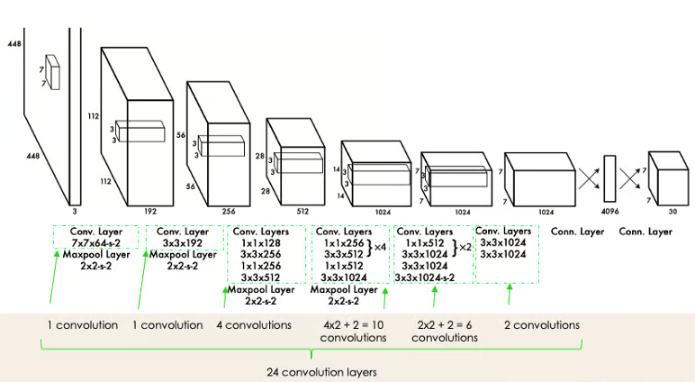

RESEARCH DESIGN / WORKFLOW / METHODOLOGY

Slide 13
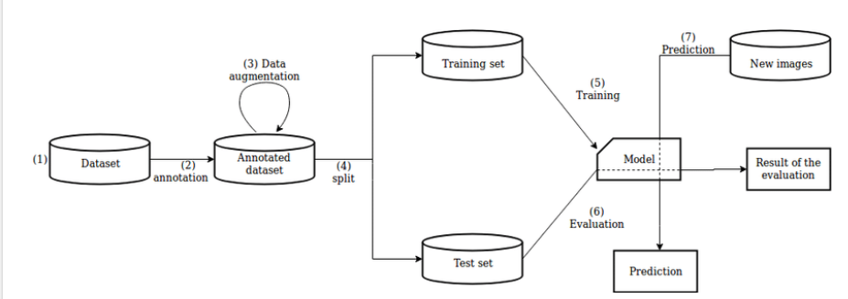
RESEARCH DESIGN / WORKFLOW / METHODOLOGY

Slide 14
ONLINE COURSE TO HELP US IN OUR IMPLEMENTATION
SL.NO. | ONLINE COURSES THAT WE ARE DOING TO HELP US IN OUR IMPLEMENTATION | DURATION(IN HOURS)
1. | Master the theory, practice,and math behind Data Science,Machine Learning,Deep Learning,NLP by KRISH NAIK (UDEMY) | 99 hours
2. | Machine Learning with Python by IBM(COURSERA) | 80 hours
3. | Machine Learning by SIMPLILEARN (YOUTUBE)

Slide 15
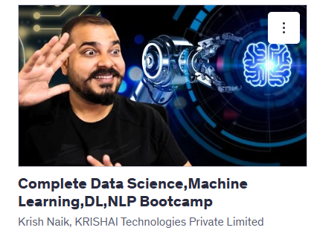
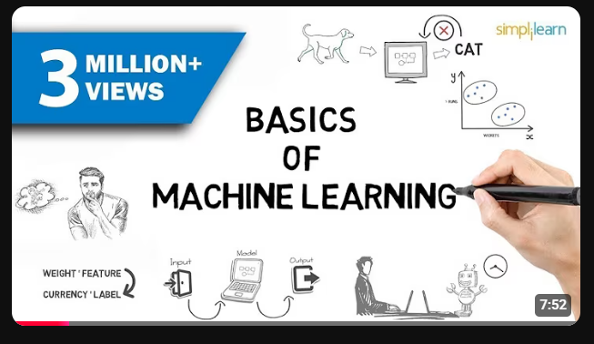
Master the theory, practice,and math behind Data Science,Machine Learning,Deep Learning,NLP by KRISH NAIK (UDEMY)
Machine Learning by SIMPLILEARN (YOUTUBE)

Slide 16
GANTT CHART
ACTIVITY | TIME FRAME
 | Feb 2025 | Mar 2025 | April 2025 | May 2025 | June 2025
Literature Survey
Problem Identification
Design
Implementation
Documentation
Proposed Activity
Activity Achived
Ongoing Activity

Slide 17
CONCLUSION
This project has so far cited the potential of hybrid learning in the field of food image processing and calorie estimation by automating food recognition, ingredient analysis and nutritional assessment.
The system not only enhances dietary awareness but also lays the foundation for future integrations such as real-time mobile tracking, API-based health app connectivity, AI-driven personalised diet recommendations, enhanced data for further research in the field of food related diseases.
By leveraging Python and PyTorch with YOLOv8 we are able to deliver real time food detection with instance segmentation capabilities.
Moving forward, further improvements such as enhanced dataset training, portion size estimation, and allergen detection will strengthen the accuracy and usability of our model. We aim to make nutritional tracking effortless and accessible for all users.

Slide 18
REFERENCES
1.Food Image Recognition and Food Safety Detection Method Based on Deep Learning.
Ying Wang, Jianbo Wu, Hui Deng, Xianghui Zeng
First published: 16 December 2021
https://doi.org/10.1155/2021/1268453
2.FOOD IMAGE ANALYSIS USING DEEP LEARNING
Dr. D.N.D. Harini (Associate Professor){Department of Computer Science and Engineering} [Gayatri Vidya Parishad College of Engineering (Autonomous)]
Dr. G. Satya Keerthi (Associate Professor){Department of Computer Science and Engineering} [Gayatri Vidya Parishad College of Engineering (Autonomous)]
Issue-5 2023
  https://ijariie.com/AdminUploadPdf/Food_Image_Processing_Using_Deep_Learning_ijariie21880.pdf? srsltid=AfmBOoo0b-jiirjdOME09RbINc_0rr3CkvrLkGUb47wej_7RMd5N6HA5

Slide 19
REFERENCES
3. “Food Calorie Estimation Using Deep Learning”. Harichandana Cherikuri1, Utkarsha Karale2, Student I2IT, Pune Student I2IT, Pune Vandana Punjabi3 Student I2IT, Pune Prof. Kamna Sahu Professor, I2IT, Pune Datta Zarikar4 Student I2IT, Pune
Microsoft Word - 13-AJ2290
4. Application of Computer Vision System in Food Processing- A Review Aasima Rafiqa, Hilal A Makroob, Poonam Sachdevaa and Savita Sharmaa
1715238129.pdf
5. Food Recognition using Ingredient-Level Features Jay Baxter Massachusetts Institute of Technology
6869_food_project.pdf
6. EXPLORING THE POTENTIAL OF IMAGE PROCESSING ON FOOD RECOGNITION LaxmanRao.Y(Assitant Professor), KeerthiSree S, Niharika G, LIkitha E, Sreeja MVL
120-july2024.pdf
7. UECFoodPix and UECFoodPix Complete : Mr Kaimu Okamoto, Prof. Keiji Yanai
8. Food Recognition 2022 : AIcrowd

